Slide 1

Northwind Traders
Sales Strategy Review
Francis Morales
Data Science Flatiron School
Notes:
During this presentation I will be covering some findings on Northwind Traders that will help put together the 2020 Sales Strategy.

Slide 2




Northwind Traders – General Info
Offices in
UK & USA with
3 Sales Repr. each
91 Active Customers from
21 different Countries
813 Orders received with
2.6 products on avg
77 Different Products from
29 Suppliers
Notes:
Northwind Traders is a retail company that sells specialty items.
It operates in 2 main Offices located in USA & UK. Each office has 3 Sales Representatives.
Serves 91 Customers from 21 different Countries
813 the total of orders placed with an average of 2.6 products per order
77 Different Products in Stock from 29 Suppliers

Slide 3
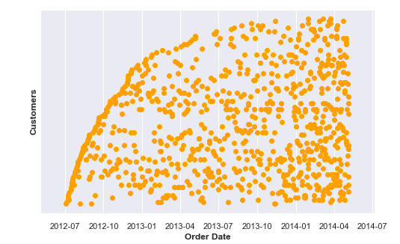
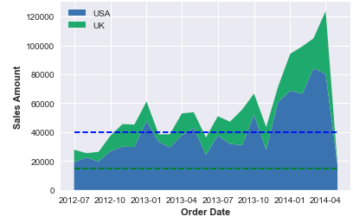
Problem Statement
New customer onboarding
Total sales over time
Notes:
Northwind has been operating since July 2012.
In recent years, the new customer on-boarding rates have decreased, as you can see in the scatter plot.The Total Sales over time has remained pretty steady over most of the company’s existence (no significant growth until last quarter).
Senior Management wants to understand the factors that might be affecting sales and profitability of the company in order to put together the 2020 strategy.

Slide 4



Methodology
Business Recommendations
Data Exploration & Descriptive Statistics
Hypothesis Testing
Notes:
The Methodology I followed was:
Data Exploration & descriptive statistics
Hypothesis testing
Analysis of results to derive business recommendations

Slide 5




Business Value
Evaluate current inventory to strengthen market position
Leveraging best practices between Northwind Sales Representatives
Create a strong strategy to increase company profitability
Notes:
Knowing Northwind customer preferences and their purchase patterns, as well as understanding internal factors that affect sales will allow the company to:
Understand market segmentation to evaluate current inventory and strengthen market position
Empower sales team to provide a better service and leverage best practices between teams
Create a strong strategy to increase company profitability

Slide 6
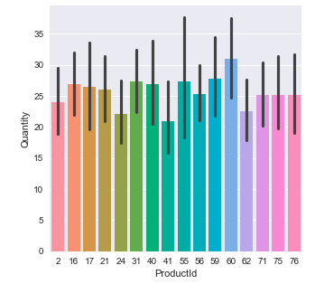
Order Frequency
2.6 Products per Order
77 Products on Inventory
30% Sales come from Best Seller Products
504/813 Orders with at least 1 top seller
Frequent Customers = Non-Frequent Customers
Best Sellers
No difference in sales between Top Seller Products
Notes:
The first study conducted was on the customer ordering frequency. The results revealed that customers that place orders with more frequency spend, on average, the same amount of money as customers that place orders with lower frequency. Therefore, the frequency of purchase is not really influencing sales.
Along with this analysis, I discovered that the average number of products per order is 2.6. Considering that Northwind traders carry 77 different products in inventory, it was worth analyzing the dynamics within products.
The top 16 Best seller products were analyzed since they bring around 30% of the total sales to Northwind. No significant difference in sales between these 16 products was found, therefore we can conclude that our sales do not depend significantly on a single product.
The chart on the slide shows the most frequent best seller products purchased together. As you can see, the frequency of pairing is pretty low considering that the company has been operating for over 2 years.
In order to increase sales, Northwind should consider reviewing the inventory to ensure the sale of competitive products that will most likely be purchased together. This will help to increase order sizes and will help Northwind become a one-stop-store for specialty products.

Slide 7
Business Recommendations
Drive customers to make BIGGER orders
Drive customers to include MORE PRODUCTS in their cart
Identify the products that are PAIRED BETTER with the company’s best sellers and include them in inventory
Consider specializing our inventory rather than having such a wide variety

Slide 8
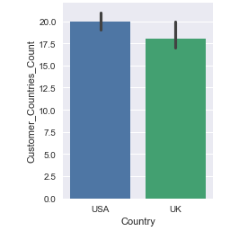
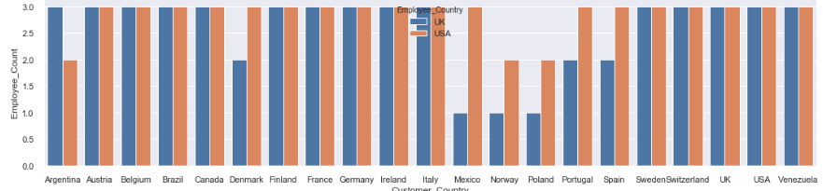
USA Sales Representatives drive higher sales
Volume of Sales per Office
Average of Customer Handling
Customer Handling by Country
Notes:
The second study was focused on customer service and sales differences between Northwind offices.
There was a significant difference on the sales between USA and UK employees.
Both offices work with the same countries, so we can assume that the difference on sales is not due to country specific customers or country specific dietary preferences.
Both offices have 3 Sales Representatives each, therefore, the difference in sales is not due to capacity of processing.
Also, USA Sales Representatives handle 20 customers on average, whereas UK Sales Representatives handle 18 customers on average.

Slide 9
Business Recommendations
Leverage USA customer service best practices in the UK office
The Inside Sales Coordinator is located in the USA, therefore, it might be good looking into having the same role opening in the UK to drive sales.

Slide 10
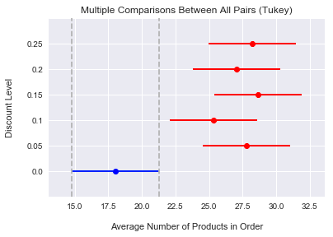
Is there an effect of discounts on quantity of sales?
Yes
Business Recommendations
Continue with discount campaigns to drive sales
Notes:
An analysis on the effect of discounts in the quantity of products sold was performed.
The study showed that there is a significant impact in the quantity of products sold when a discount campaign was applied.
The business recommendation is to continue with discount campaigns to drive sales

Slide 11
Future Work
Study customer loyalty, customer retention and rate of growth
Study if there are certain products consumed significantly in a particular country
Gather more data to be able to study product specific behavior

Slide 12

Notes:
And with this, we conclude the first study of factors that are impacting Northwind sales levels.
Thank you!

